Slide 1
SESS: Self-Ensembling Semi-Supervised 3D Object Detection
Na Zhao, Tat-Seng Chua, Gim Hee Lee CVPR 2020

Slide 2
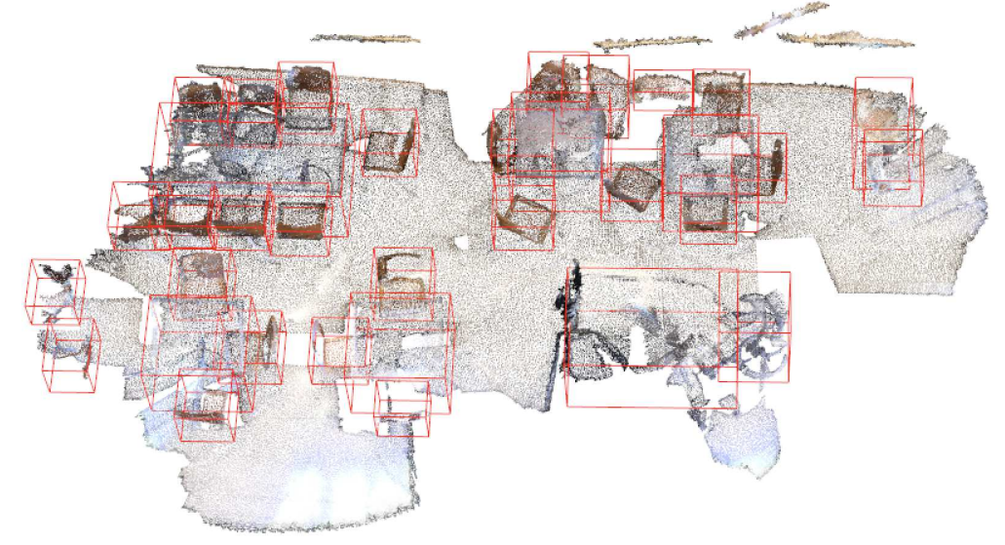
3D Object Detection
Estimate the object category and oriented 3D bounding box for all objects in the 3d scene

Slide 3
What is oriented 3D bounding box

Slide 4
3D bounding box - 2 type
Axis-Aligned Bounding Box
Oriented Bounding Box

Slide 5
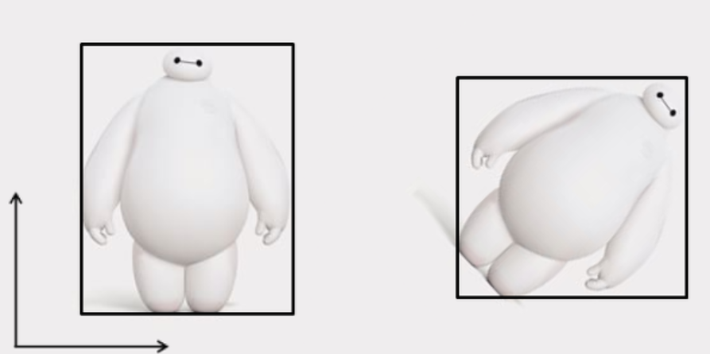
Axis-Aligned Bounding Box

Slide 6
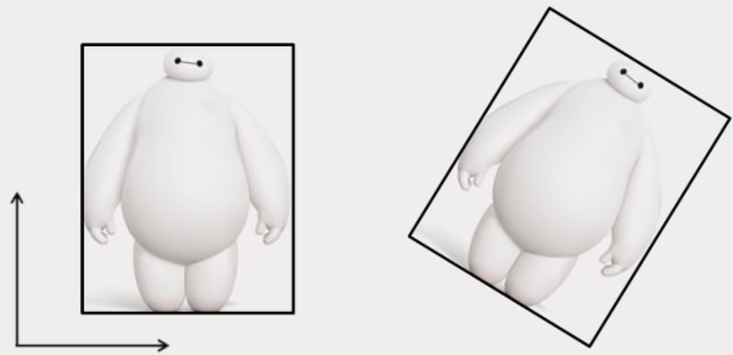
Oriented Bounding Box

Slide 7
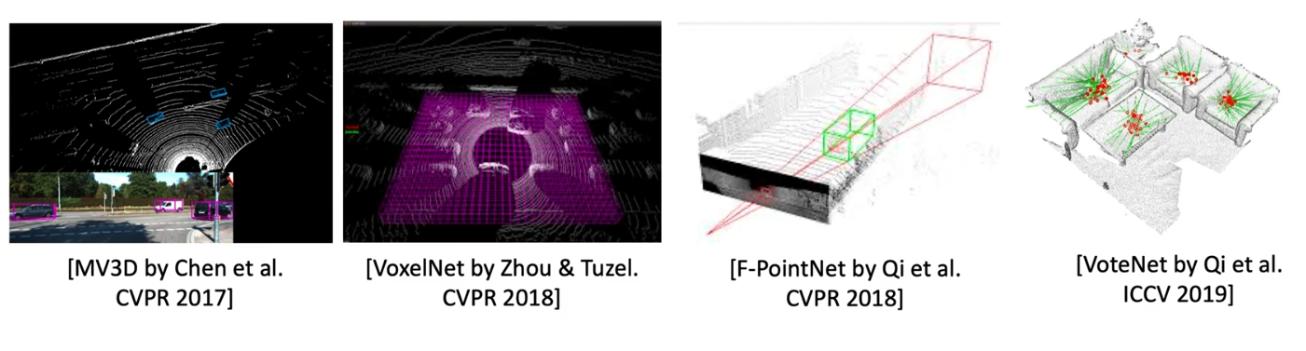
Previous 3D Object Detection Approaches
Require the availability of a large amount of well-annotated 3D data

Slide 8
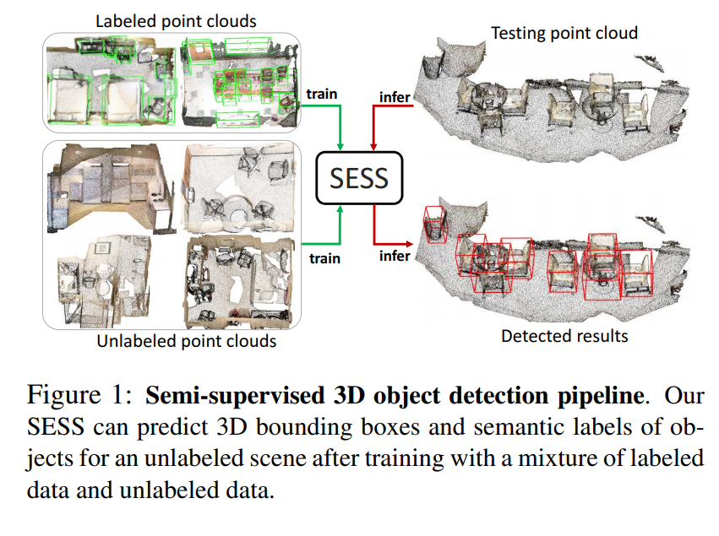
Semi-supervised 3D object detection

Slide 9
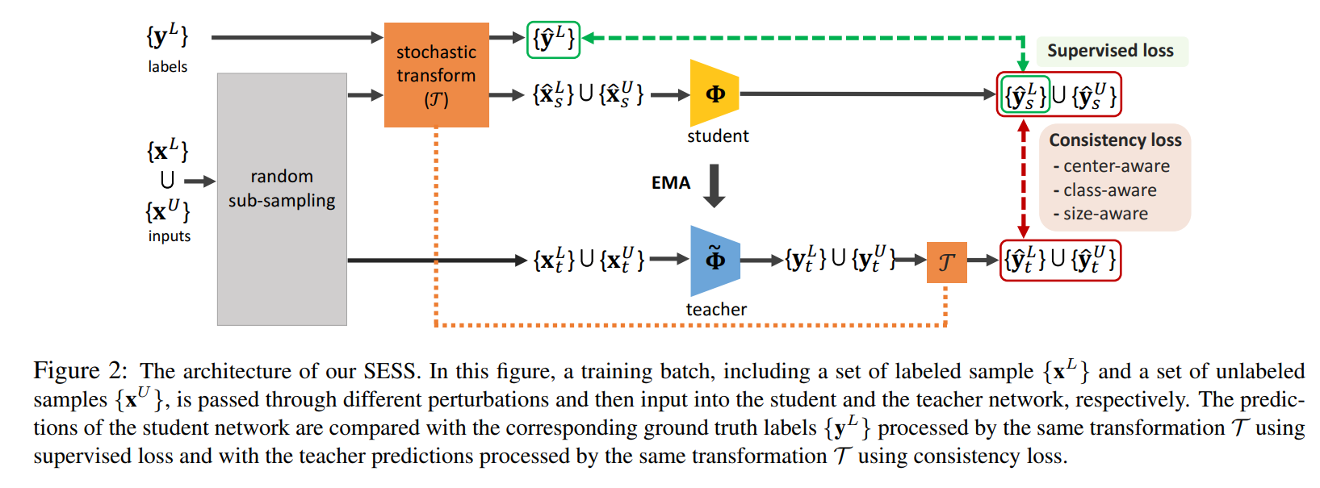
architecture of SESS

Slide 10
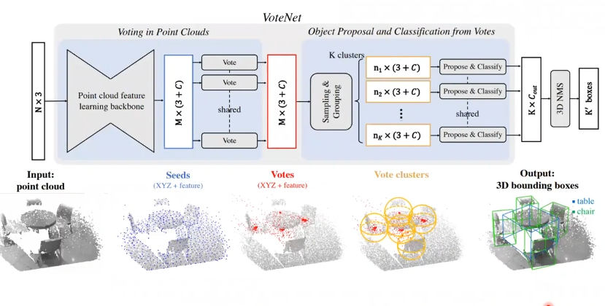
Backbone : Fully Supervised VoteNet

Slide 11
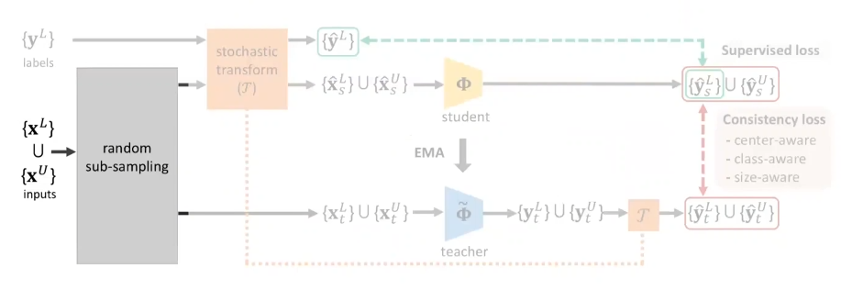
architecture of SESS
Randomly sub-sample from a mixture of labeled and unlabeled point clouds
to get two sets of point clouds

Slide 12
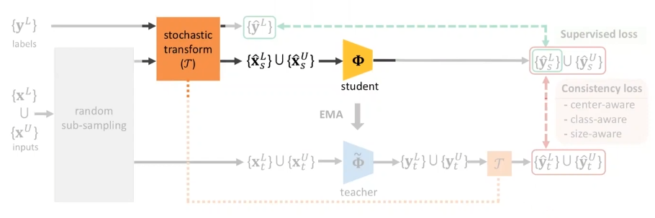
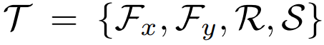
architecture of SESS
Input to student network :
- Random flipping along x- or y-axis
- Random rotation around upright axis →
- Random scaling

Slide 13
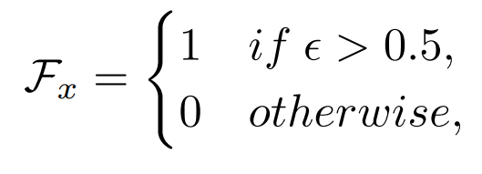
Random flipping along x- or y-axis
Where ϵ is a random variable uniformly sampled from [0,1]

Slide 14
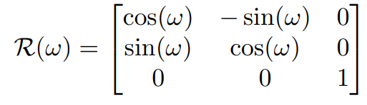
Random rotation around upright axis
Random scaling
Random scaling of points S that is uniformly sampled from [a,b]

Slide 15
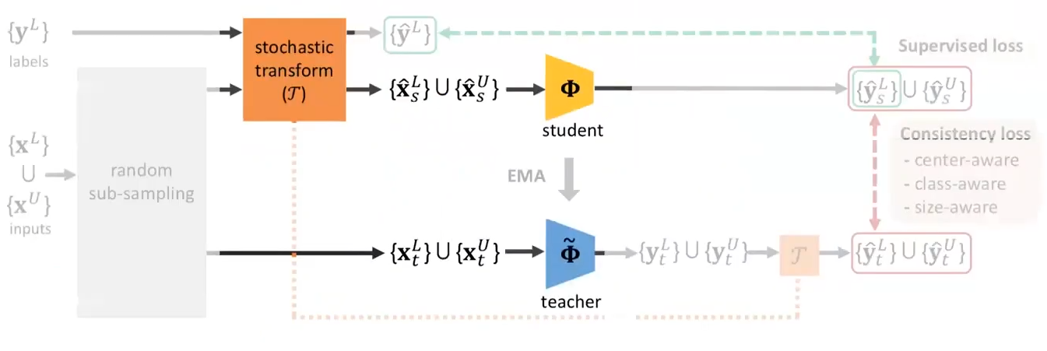
architecture of SESS
Input to teacher network : Unperturbed 3D point cloud.

Slide 16
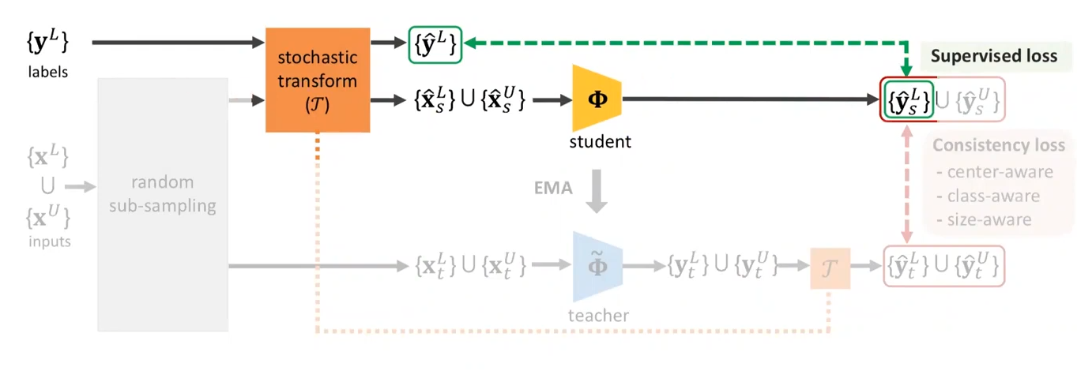
architecture of SESS
Supervised loss

Slide 17
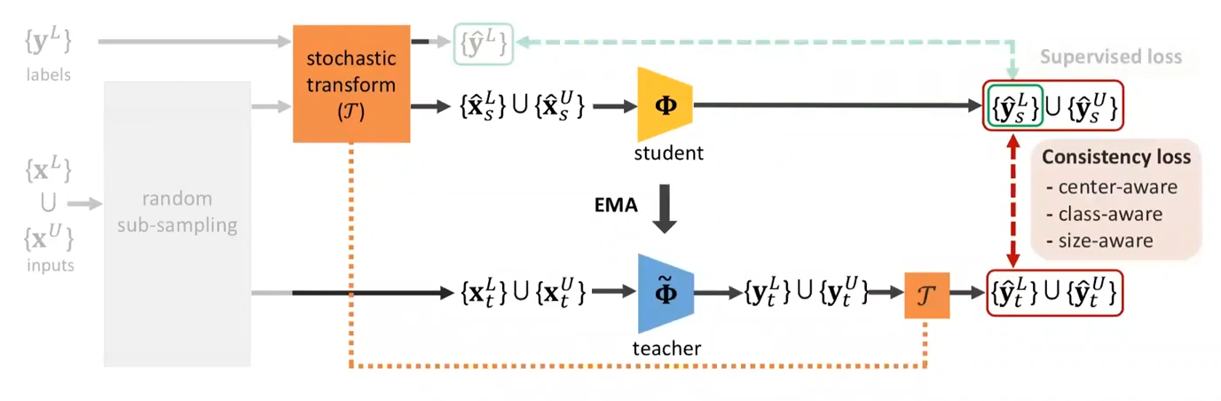
architecture of SESS
Consistency loss

Slide 18
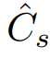
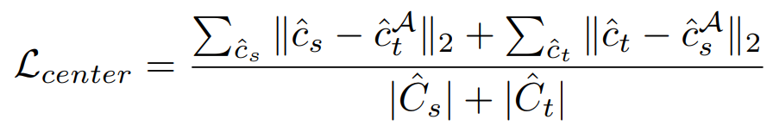
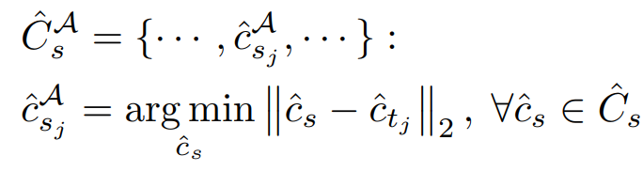
Consistency loss
Center-aware consistency loss
minimize alignment errors between teacher and student
we do the alignment by searching for the its nearest neighbor in based
on the minimum Euclidean distance between the centers of the bounding boxes.

Slide 19
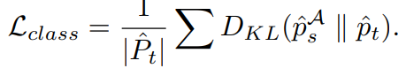
Consistency loss
Class-aware consistency loss
Minimize KL-divergence between class probabilities

Slide 20
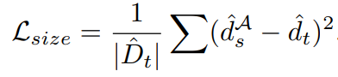
Consistency loss
Size-aware consistency loss
MSE between sizes of bboxes predicted by student and teacher

Slide 21
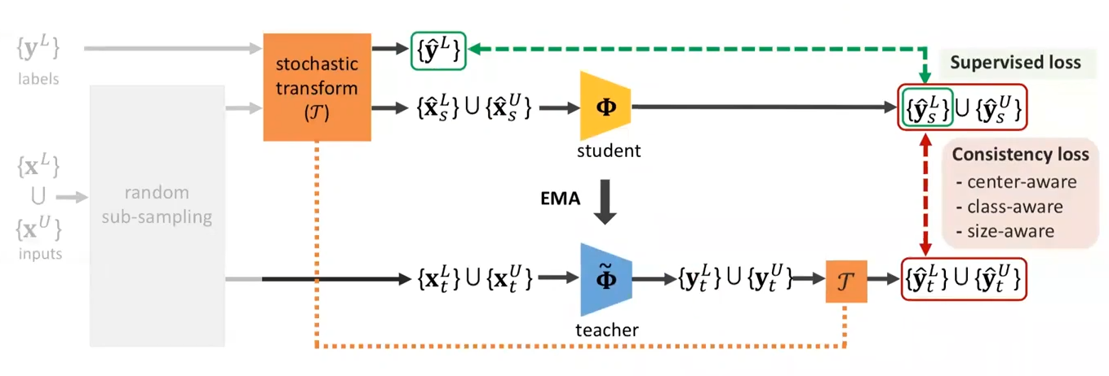
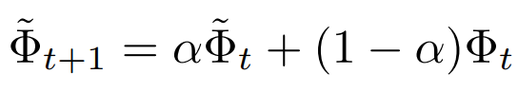
exponential moving average (EMA)
Updated parameters from the student network are used in an EMA to update the teacher network

Slide 22
exponential moving average (EMA)
Finally, the parameters of the student network Φ is updated via gradient descent at training step t, and then the updated parameters from the student network are used in an exponential moving average (EMA) to update the parameters of the teacher network Φ˜:
α is a smoothing hyper-parameter that controls how much information the teacher takes from the student network.

Slide 23
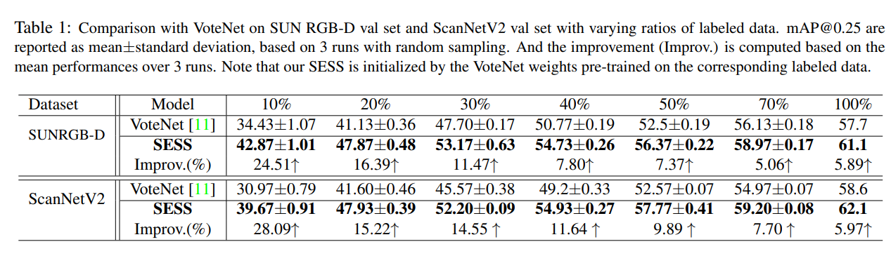
Comparison with Fully-supervised Methods

Slide 24
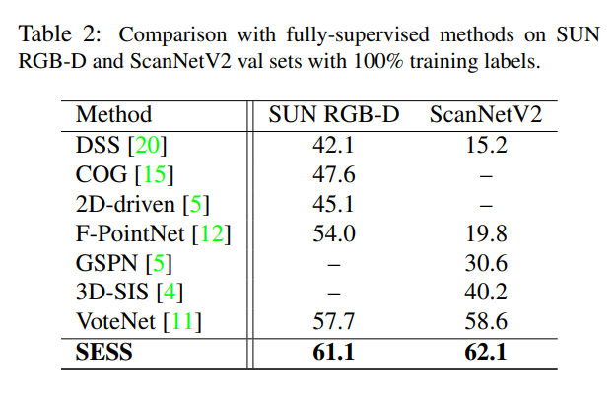
Comparison with Fully-supervised Methods

Slide 25
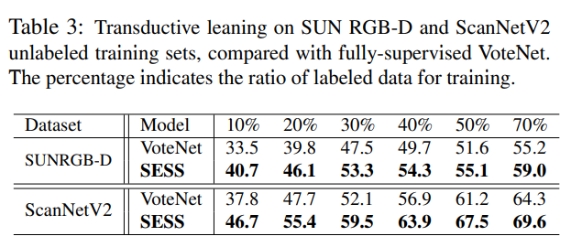
Comparison with Fully-supervised Methods
In inductive learning, the goal is to generalize correct labels for new unseen data.
In transductive learning, the goal is infer the labels restricted to the given unlabeled data.

Slide 26
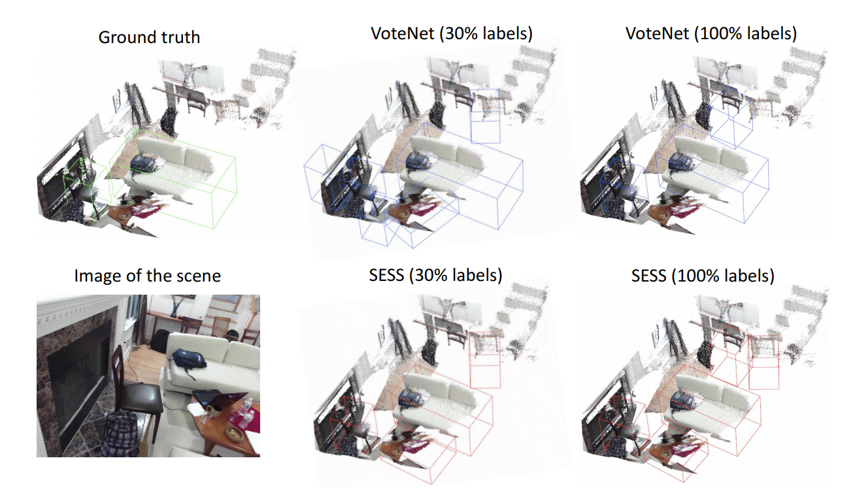
Qualitative Results and Analysis

Slide 27
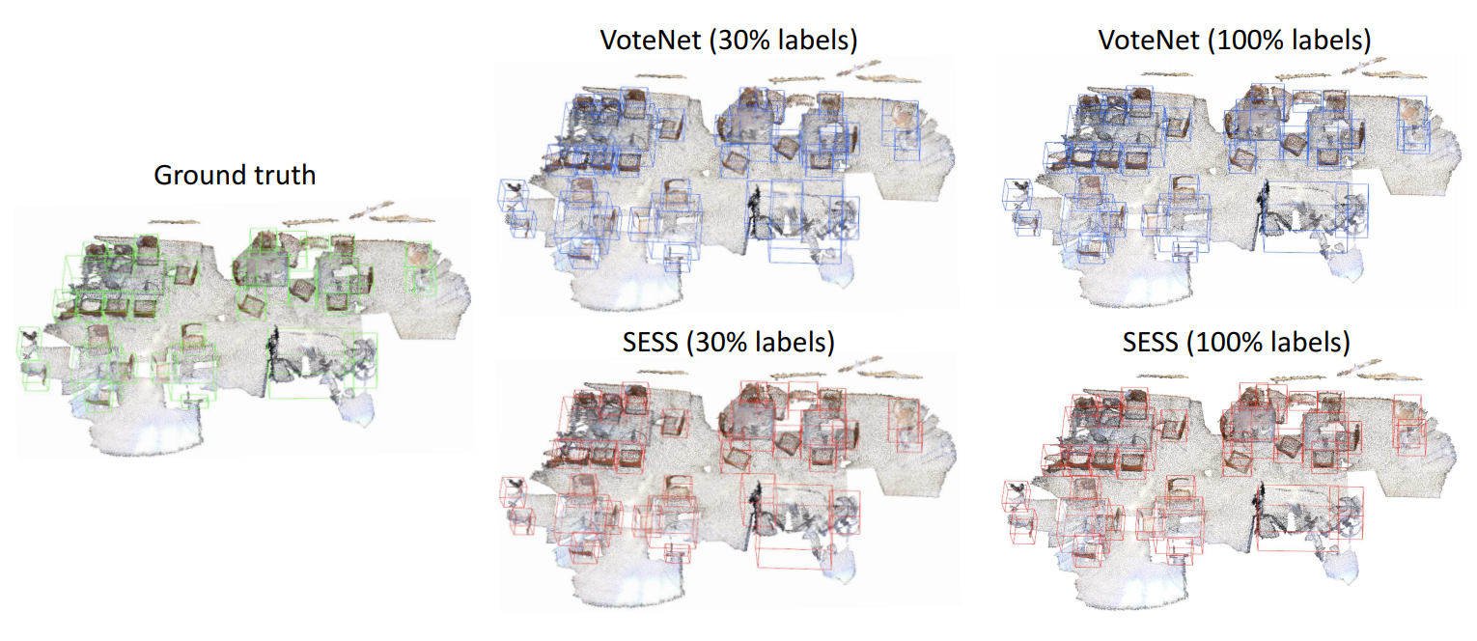
Qualitative Results and Analysis

Slide 28
감사합니다.

